Slide 1
19CS3113S
Analysis and Design of Algorithms
Session -28

Slide 2
Graph Coloring
Let ‘G’ be a graph and ‘m’ be a given positive integer. If the nodes of ‘G’ can be colored in such a way that no two adjacent nodes have the same color. Yet only ‘M’ colors are used. So it’s called M-color ability decision problem.
The graph G can be colored using the smallest integer ‘m’. This integer is referred to as chromatic number of the graph.
A graph is said to be planar iff it can be drawn on plane in such a way that no two edges cross each other.
Suppose we are given a map then, we have to convert it into planar. Consider each and every region as a node. If two regions are adjacent then the corresponding nodes are joined by an edge.

Slide 3
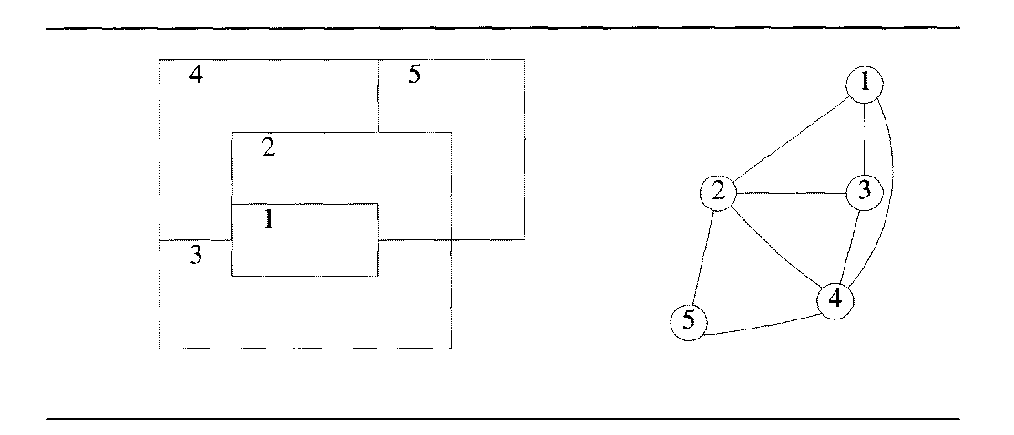

Slide 4
Steps to color the Graph:
First create the adjacency matrix graph(1:m,1:n) for a graph, if there is an edge between i,j then C(i,j) = 1 otherwise C(i,j) =0.
The Colors will be represented by the integers 1,2,…..m and the solutions will be stored in the array X(1),X(2),………..,X(n) ,X(index) is the color, index is the node.
He formula is used to set the color is,
X(k) = (X(k)+1) % (m+1)
First one chromatic number is assigned ,after assigning a number for ‘k’ node, we have to check whether the adjacent nodes has got the same values if so then we have to assign the next value.
Repeat the procedure until all possible combinations of colors are found.
The function which is used to check the adjacent nodes and same color is,
If(( Graph (k,j) == 1) and X(k) = X(j))

Slide 5
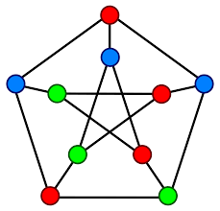
Graph coloring example

Slide 6
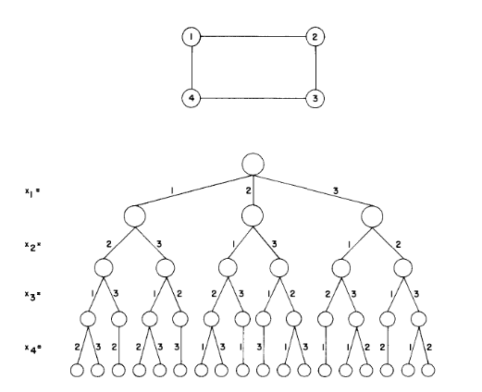
A 4 – node Graph and all possible 3 colorings

Slide 7
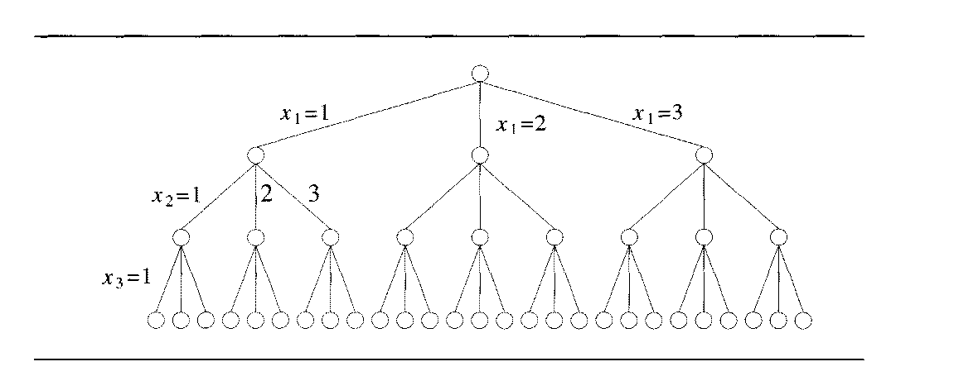

Slide 8
Algorithm mColoring(k)
// the graph is represented by its Boolean adjacency matrix G[1:n,1:n] .All assignments //of 1,2,……….,m to the vertices of the graph such that adjacent vertices are assigned //distinct integers are printed. ’k’ is the index of the next vertex to color.
{
repeat
{ // generate all legal assignment for X[k].
Nextvalue(k); // Assign to X[k] a legal color.
If (X[k]=0) then return; // No new color possible.
If (k=n) then // Almost ‘m’ colors have been used to color the ‘n’ vertices
Write(x[1:n]);
Else mcoloring(k+1);
}until(false);
}

Slide 9
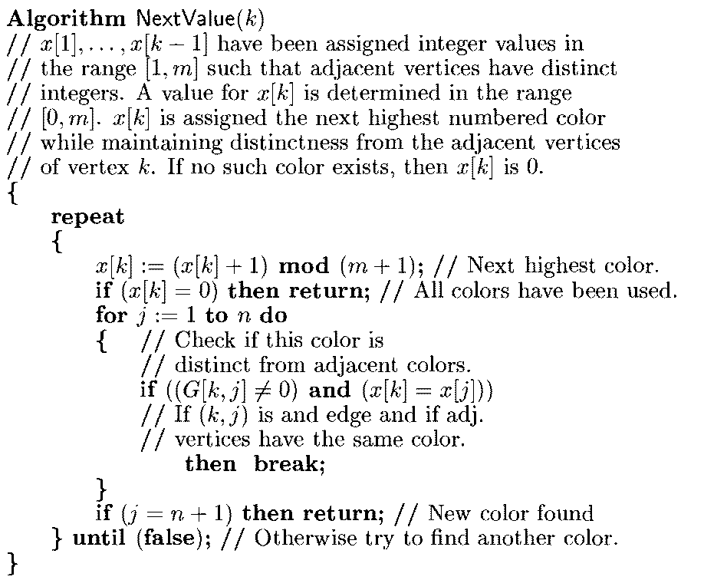

Slide 10
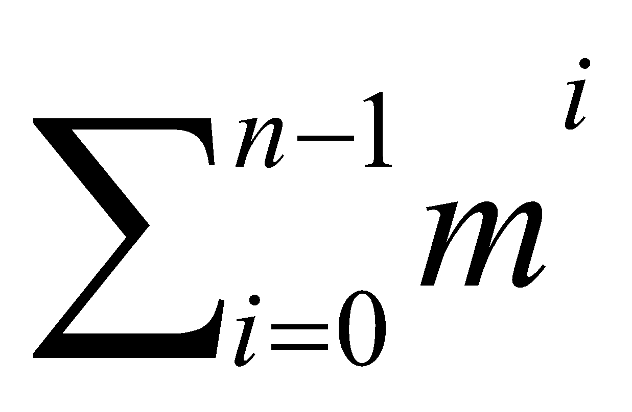
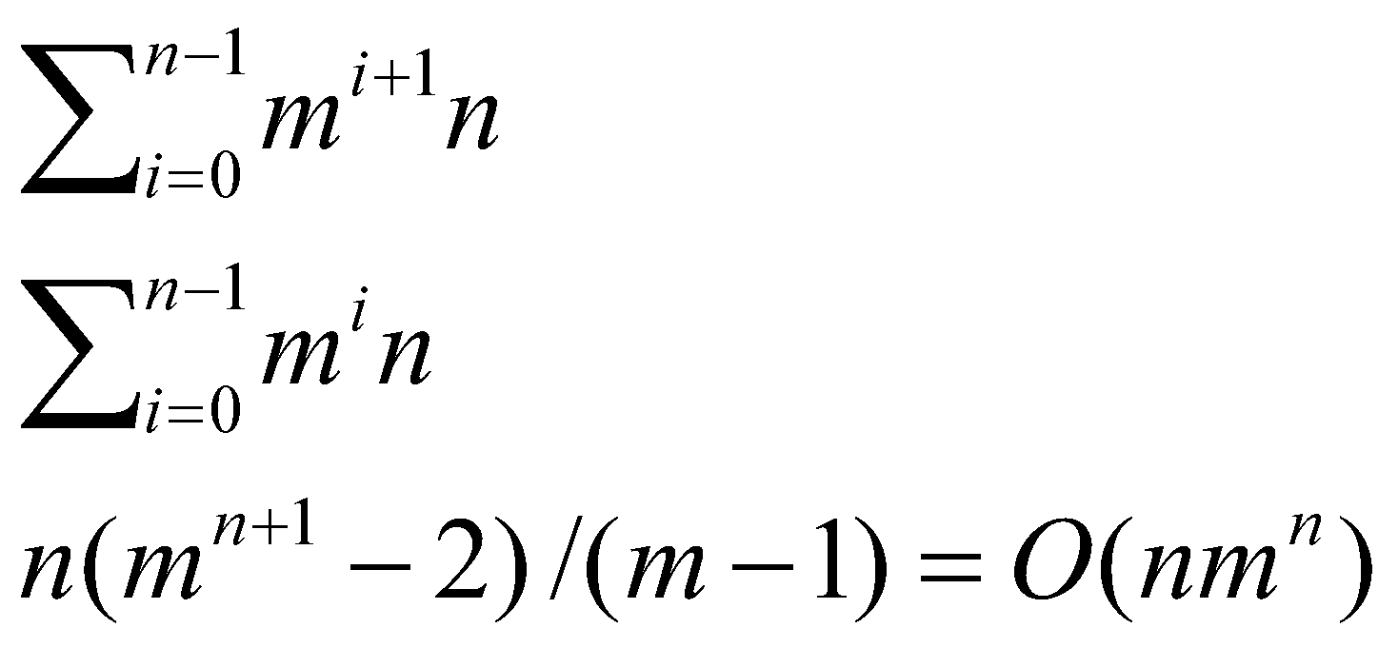
Time complexity:
An upper bound on the computing time of mColoring can be derived at by noticing that the number of internal nodes in the state space tree is:
At each internal node, O(mn) time is spent by NextValue to determine the children corresponding to legal colorings.
Hence the total time is bounded by:

Slide 11
Thank you

